Slide 1

FALL 2023
MIS 381N
Information management
Lecture 21
Oct 30th 2023
Prashant D. Joshi
UT McCombs School of Business (MSBA), The University of Texas at Austin

Slide 2

Objectives
Introduction to Snowflake
Progress on Final Projects
Quick intro to Snowflake
Questions and discussion

Slide 3
What questions may I answer before we begin …
All questions are good questions

Slide 4
Housekeeping
Project Status Update from each group representative
Status of Hadoop/MapReduce homework?
Kubernetes homework on Canvas. Can work in groups of 2 (maybe 3). Due date: Nov 5th
Snowflake homework on Canvas. Can work in groups of 2 (maybe 3). Due date: Nov 17th

Slide 5
Homework
Assignment 6:
Info: https://www.snowflake.com/blog/learn-snowflake-with-free-hands-on-workshops/
Obtain the badge 1 and upload the screenshot as your homework: https://learn.snowflake.com/en/courses/uni-essdww101/
It will take about 8 hours to finish. Plan accordingly.
Can work in groups of 2 or 3

Slide 6

Snowflake

Slide 7
Key Objectives
Understand the fundamentals of the Snowflake Architecture
Explore the benefits of clound-based data warehousing
Learn how Snowflake can simplify data management and analytics

Slide 8
Agenda
What is snowflake
Architecture
Virtual Warehouses
Data Sharing
Security and Compliance

Slide 9
What is snowflake?
Fully managed, scalable, and easy to use solution for storing and analyzing data that is entirely on a cloud data warehouse platform
Designed to handle large volumes of data and has high and quick scalability
Cloud-host agnostic (can run on various providers such as AWS, Azure, etc)

Slide 10
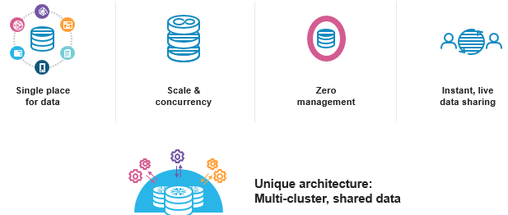
Key Features
Separation of storage and compute
Instant ‘elasticity’ to scale up/down based on query/task needs on the fly
delay/bottlenecks are reduced
Resource isolation with virtual warehouses, thus different teams have dedicated compute servers
Cost efficiency
Workload isolation means heavy workloads don’t impact other concurrent tasks
Support for structured and unstructured data
Built-in security features
Support for data sharing across orgs
Perf optimization
Ease of use for various users such as data analysts, engineers, data scientists
https://www.bing.com/ck/a?!&&p=ddf3a1fb3d9cef84JmltdHM9MTY5ODUzNzYwMCZpZ3VpZD0yOGZmOTg4NC04MmRhLTY0YjEtM2I2OC04YTI0ODM5MzY1ZWEmaW5zaWQ9NTI3MQ&ptn=3&ver=2&hsh=3&fclid=28ff9884-82da-64b1-3b68-8a24839365ea&psq=Snowflake+lecture+slides&u=a1aHR0cHM6Ly93d3cuc25vd2ZsYWtlLmNvbS93cC1jb250ZW50L3VwbG9hZHMvMjAxOS8wNi9Tbm93Zmxha2VfVGVtcGxhdGVfbGlnaHQtMjAxOS5wcHR4&ntb=1

Slide 11
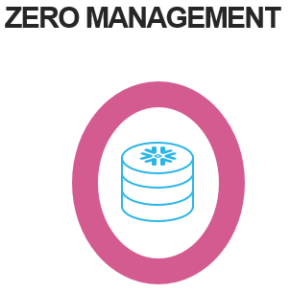
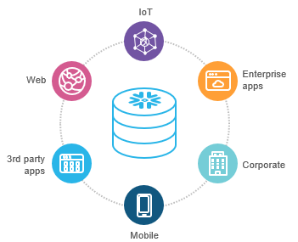
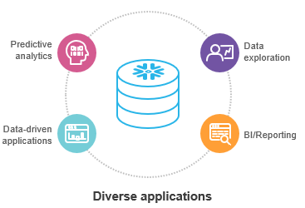
How snowflake is different
Zero Management
Load data and run queries
Data from various sources
Structured and semi-structured (JSON, XML,…)
Centralized storage of data, accessible by any user/app
Multiple diverse users

Slide 12
Agenda
What is snowflake
Architecture
Virtual Warehouses
Data Sharing
Security and Compliance

Slide 13
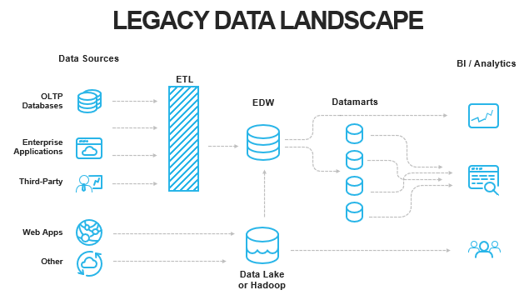
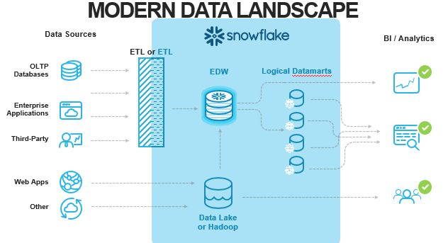
Where Snowflake fits in the flow

Slide 14
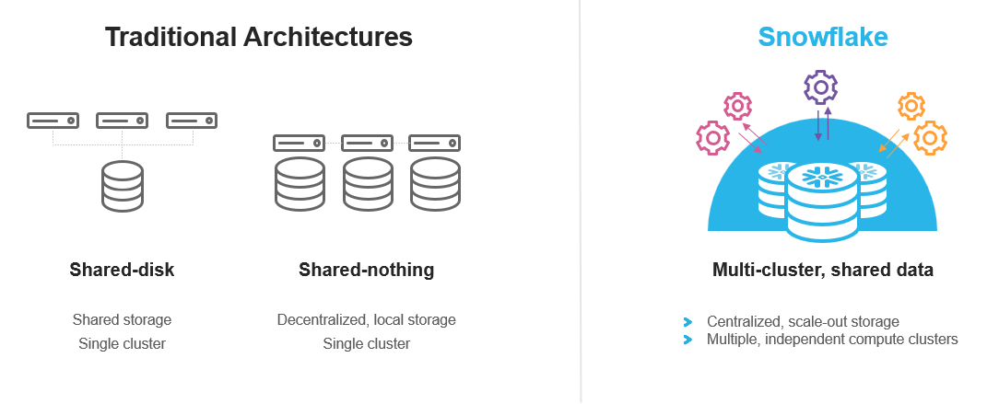
Snowflake architecture for data warehousing
Multi-culture, shared data, in the cloud

Slide 15
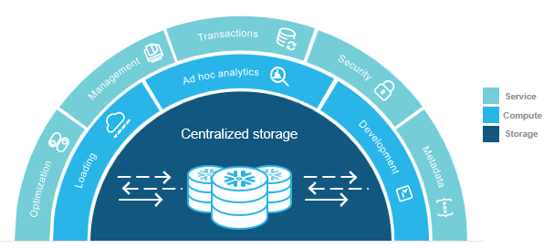
Three tiered architecture
Data storage layer
Compute Clusters (virtual warehouses)
Users and applications
Cloud based storage (AWS, Azure, etc);
Columnar Database
Separate data storage and compute, allowing independent scaling

Slide 16
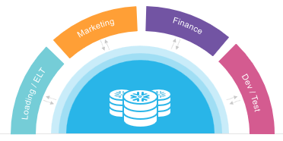
Storage and compute separation
Storage being separated from compute can grow without adding nodes
Resize compute instantly depending on business needs
Multiple clusters access data without contention
ETL, reporting, data science, applications run concurrently without performance impact

Slide 17
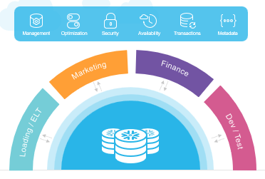
Global services
Separate metadata from storage and compute
Full transactional consistency across entire system (ACID compliant)

Slide 18
Agenda
What is snowflake
Architecture
Virtual Warehouses
Data Sharing
Security and Compliance

Slide 19
Virtual Warehouse
Main features
On-demand scalability/elasticity
Concurrent query processing
Customizability
Cost efficiency

Slide 20
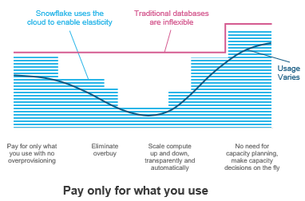
Scaling/Elasticity
Auto-suspend, auto resume
Resource increase/decrease based on query loads

Slide 21
Real life example…
Black Friday sales approaching…
Traditional approach? Manually provision additional resources well in advance
Will get wasted while the surge has not yet hit
Snowflake Virtual Warehouse? As customers flood the website, Snowflake detects the load and automatically allocated more resources
The e-commerce platform does not need to worry about resource management
Snowflake’s elasticity ensures that the platform can process sales, track inventory, and perform real-time analysis without delays
As the demand subsides, resources are automatically released
Cost effective to the e-commerce platform

Slide 22
Agenda
What is snowflake
Architecture
Virtual Warehouses
Data Sharing
Security and Compliance

Slide 23
Data Sharing
Snowflake allows data sharing
Secure
Granular
Real-Time Data Access
Zero Data Movement

Slide 24
Data Sharing
Secure Data Sharing
Encryption
Access Control
Authentication
Granular Control
Precise access to data, tables, or views
Type of access (R, W, etc)
Real Time
Changes to source data are instantly reflected in shared data
Zero Data Movement
No data moves between accounts
Sharing through metadata, reducing data redundancy and storage costs

Slide 25
Agenda
What is snowflake
Architecture
Virtual Warehouses
Data Sharing
Security and Compliance

Slide 26
Security in Snowflake
Protection of data and compliance with industry standards
Data encryption at rest and in transit
Role-based access control
Multi-factor authentication
Audit trail and monitoring
Data masking and redaction

Slide 27
Compliance in Snowflake
Commitment to data governance and integrity
SOC2 Type II (compliance standards on Security, Availability, Processing integrity, Confidentiality, Privacy)
Finance: PCI DSS
Healthcare: HIPAA
Data Protection: GDPR (Comprehensive data protection regulation from the European Union)
FedRAMP (US Govt-wide standardized security assessment)

Slide 28
View this video for cool features of Snowflake
Snowflake features video: https://www.bing.com/videos/riverview/relatedvideo?q=Demo+of+Snowflake+working&mid=DB66E81C8506A0977467DB66E81C8506A0977467&FORM=VIRE

Slide 29

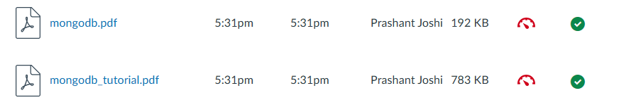
Next class
Topic Focus: MongoDB
Prereading: In Canvas → Files → Reading

Slide 30
What questions may I answer before we conclude …
All questions are good questions

Slide 31
Appendix

